Slide 1



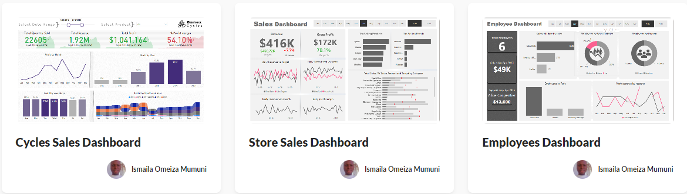




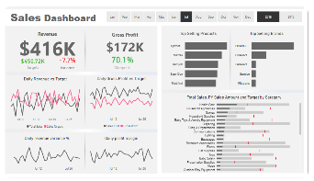
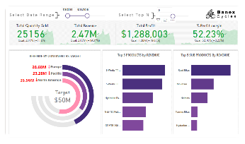
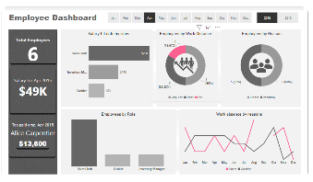



Ismaila M. Omeiza
Data visualization engineer
Skills
Skills
Interest
Interest
Language
Language
Work Experience by Company
2019
2016
2008
2005
Education
Education
Portfolio
Portfolio
Maven
KSP

